Slide 1
Term Project Iteration 1 Walkthrough

Slide 2
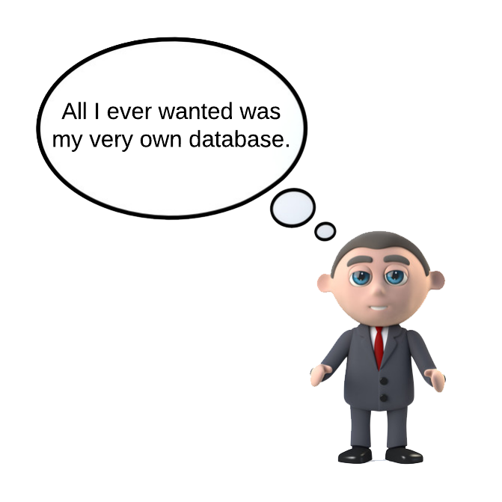
Your Very Own Database
Notes:
You have a chance to design, implement, and start using your very own database all in one course term.
You decide what data is stored in your database.
The database will be live in Oracle, SQL Server, or Postgres even before the end of the term.
The start-to-finish experience you gain from this project will help prepare you for database work in the industry or academia.

Slide 3
By the End of the Term
Database Design Document
You will build this week by week to convey your design.
Set of SQL Scripts
As your design nears completion, you will implement it with a set of SQL scripts.

Slide 4
Iteration 1 Components
Project Direction Overview
You provide an overview that describes who the database will be for, what kind of data it will contain, how you envision it will be used, and most importantly, why you are interested in it.
Use Cases and Fields
You provide use cases that enumerate steps of how the database will be typically used, also identify significant database fields needed to support the use case.
Summary and Reflection
You concisely summarize your project and the work you have completed thus far, and additionally record your questions, concerns, and observations, so that you and your facilitator or instructor are aware of them and can communicate about them.

Slide 5
Project Direction Tips
Create a complete scenario as you can. This will help you determine your scope of the project, and your facilitator will understand where you are coming from and can better provide you guidance.
Find an area you like and/or understand well.
Put a lot of thought into what kinds of long-term data needs to be stored for your scenario.

Slide 6
TrackMyBuys Example
I created an example for a mobile application named “TrackMyBuys”.
I work through each component that you are required to complete.
Mine is just a sample for a guide. Yours might be better than mine and will probably be in a completely different area.

Slide 7
Use Cases and Fields
You define at least three use cases that enumerate steps of how the database will be typically used, and identify significant database fields needed to support the use case.
This helps you and your facilitator understand how a person or application interacts with your database.

Slide 8
Use Cases and Fields
Focus on how your database will be typically used; don't get caught up in exceptions or rare cases, though you can use them to highlight something if it helps your description.
Focus on how the data is stored long-term, not how the data flows through the application.

Slide 9
Use Case Example
Account Signup/Installation Use Case
The person visits TrackMyBuys’ website or app store and installs the application.
The application asks them to create an account when its first run.
The user enters their information and the account is created in the database.
The application asks them to install browser plugins so that their purchases can be automatically tracked when they make them.

Slide 10
Use Case Example Fields
Field | What it Stores | Why it’s Needed
AccountName | This field stores a summary name associated with each account, | In case the same person has more than one account, they can select the correct one from a dropdown list.
FirstName | This is the first name of the account holder. | This is necessary for displaying the person’s name on screens and addressing them when sending them emails or other communications.
LastName | This is the last name of the account holder. | This is necessary for displaying the person’s name on screens and addressing them when sending them emails or other communications.
CustomerSince | This is the date the account what was created. | This is useful for determining the age of an account, which is useful for a variety of reasons, such as giving discounts to long-term customers, customer retention, etc …
AccountBalance | This is the balance owed by the customer. | This is useful to keep track of customers that owe money to use the application.

Slide 11
Summary and Reflection
Concisely summarize your project and the work you have completed in your design document.
Your summary need not be long.
Here you also write down your questions, concerns, and observations so that you and your facilitator or instructor are aware of them and can communicate about them.

Slide 12
Summary and Reflection
What are some concepts you think may need more refinement in this design?
Is there other related data that may be needed?
Are you particularly concerned about an aspect of the project?
Anything that’s important to you, put it down.

Slide 13
Evaluation

Slide 14

End

